Slide 1
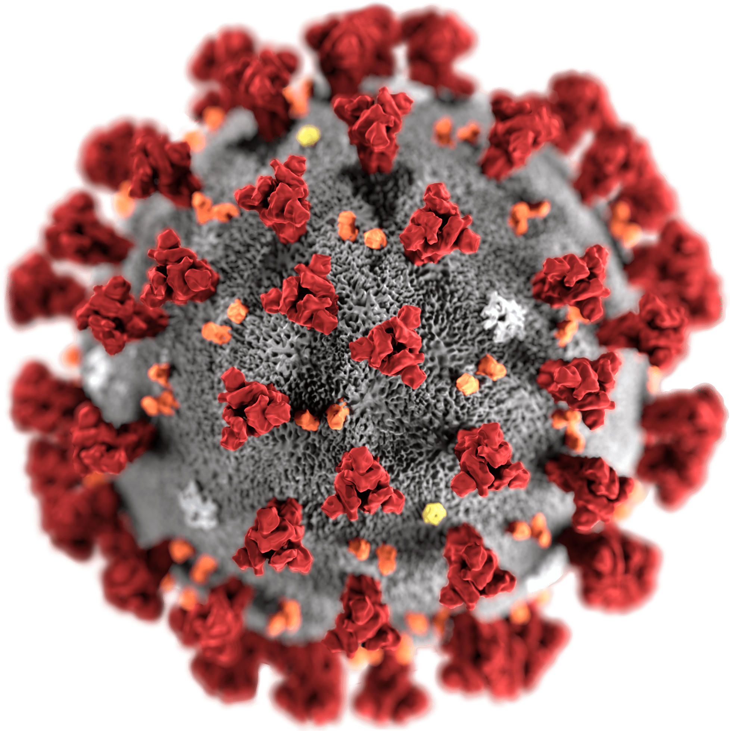
covid19.analytics and coronavirus
Name: Elif Nur Aslıhan Celepoğlu
Student ıd: 1904010023
Lecturer: DUYGU DEMİRAY
Lesson: Artificial Intelligence

Slide 2

MY STEPS
First I pulled the data from open source.
There are two different data. I analyzed them how many rows and columns.
I showed the data graphically.
I covered the countries with the most coronavirus.These are turkey, china and us.
I made a world map corona app based on primary data, i.e. corona analysis data.
I examined the number of corona, confirmed numbers and death numbers on the corona general data in the secondary data.
In this way, I analyzed the data and prepared a presentation file.

Slide 3
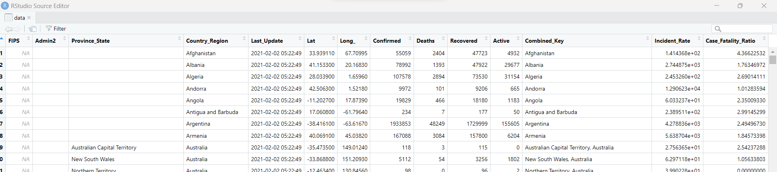
covid19.analytics
(4016 rows , 14 cloumn)

Slide 4
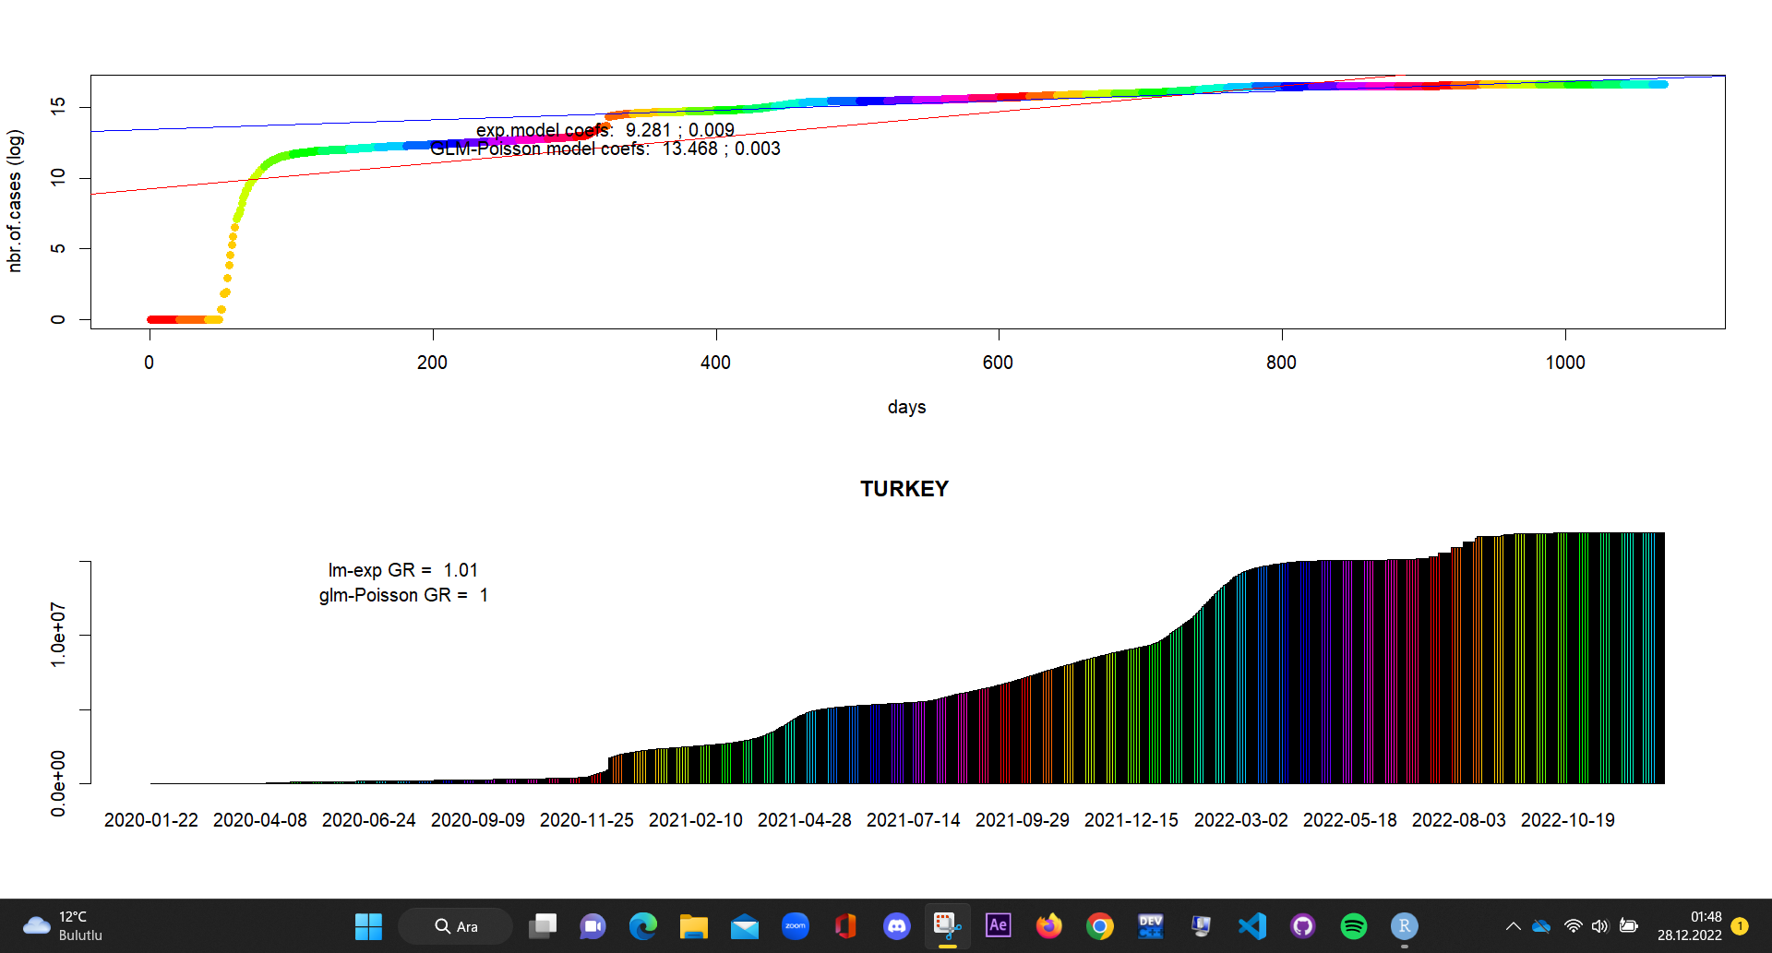
The case in Turkey by date

Slide 5
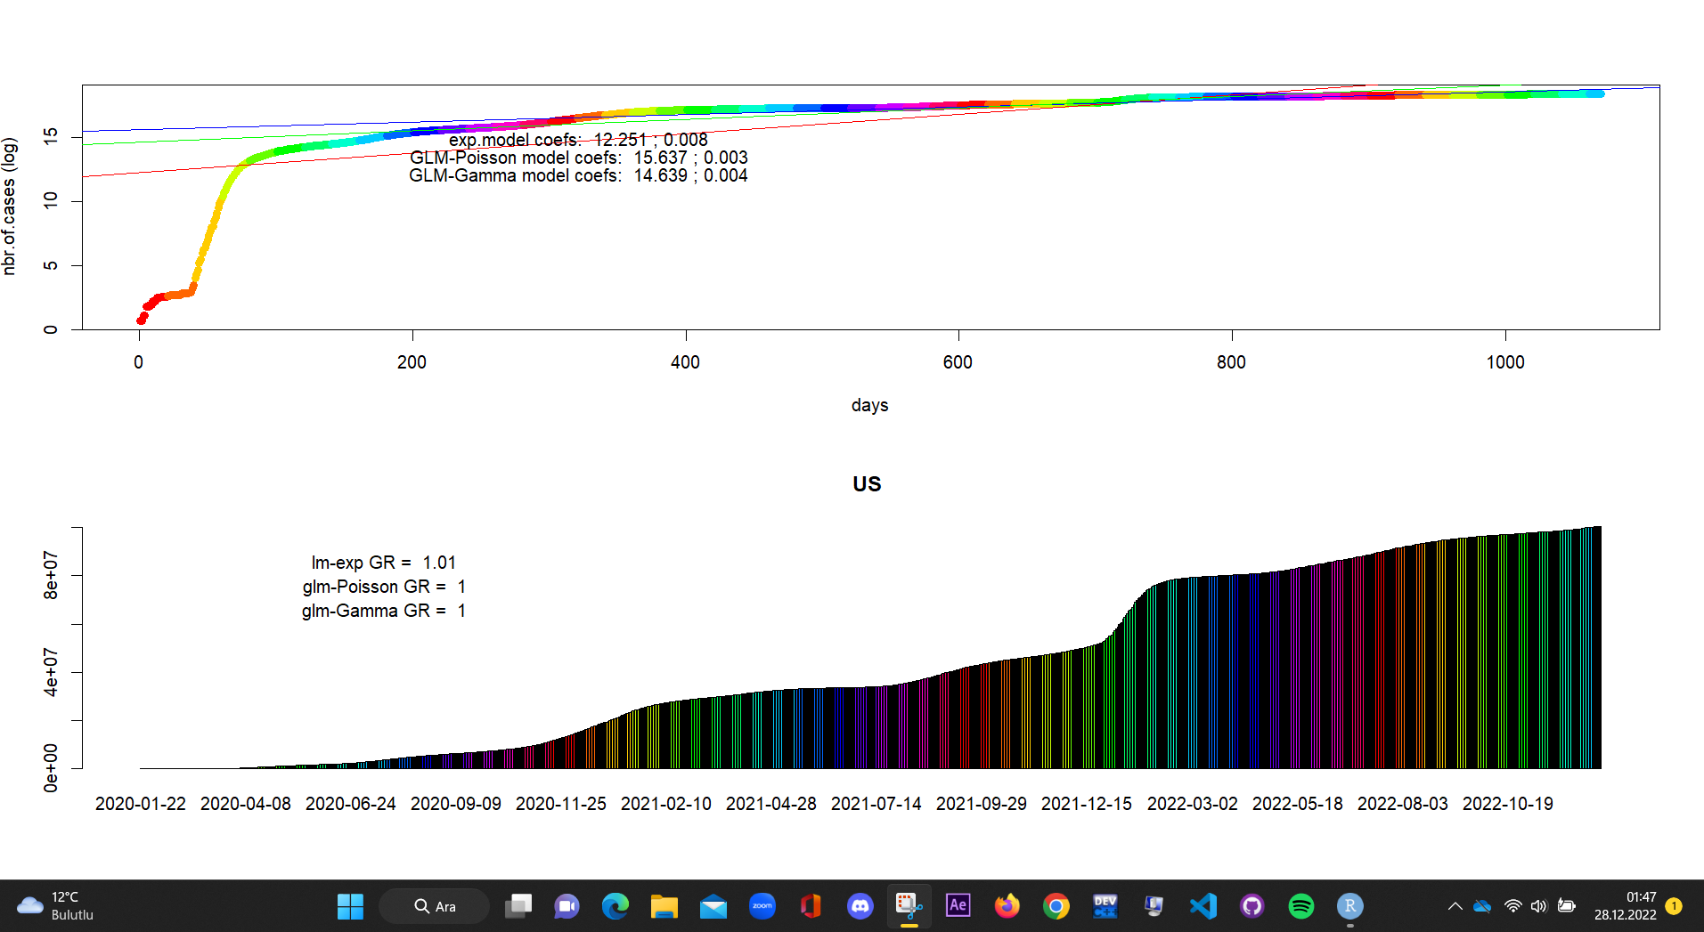
The case in US by date

Slide 6
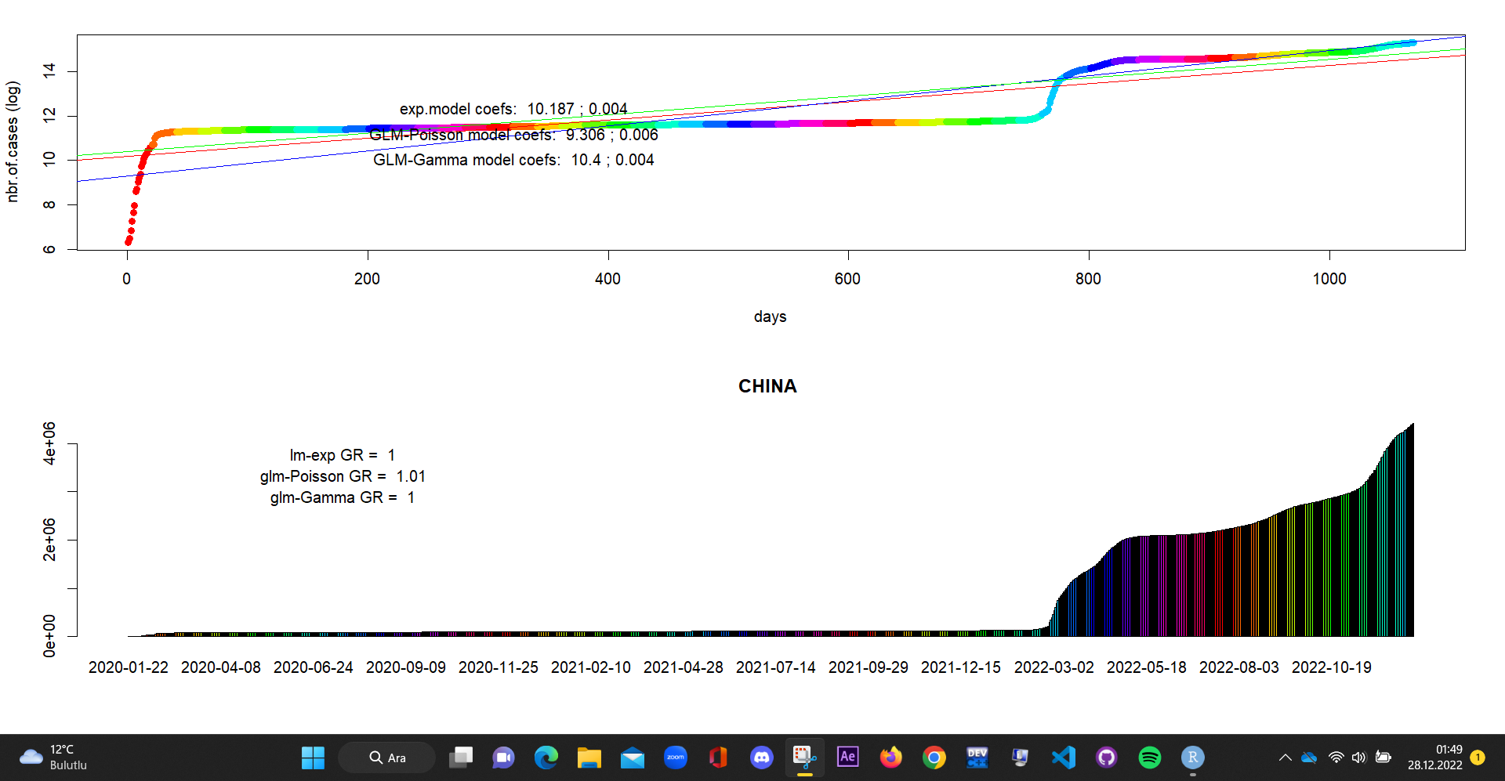
The case in China by date

Slide 7
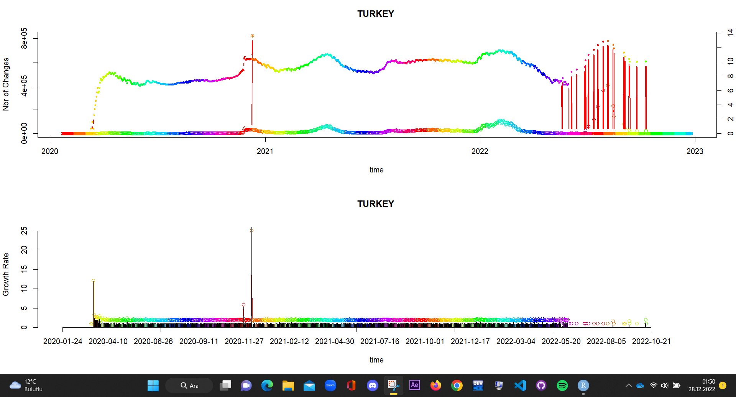
Turkey growth rate and change

Slide 8
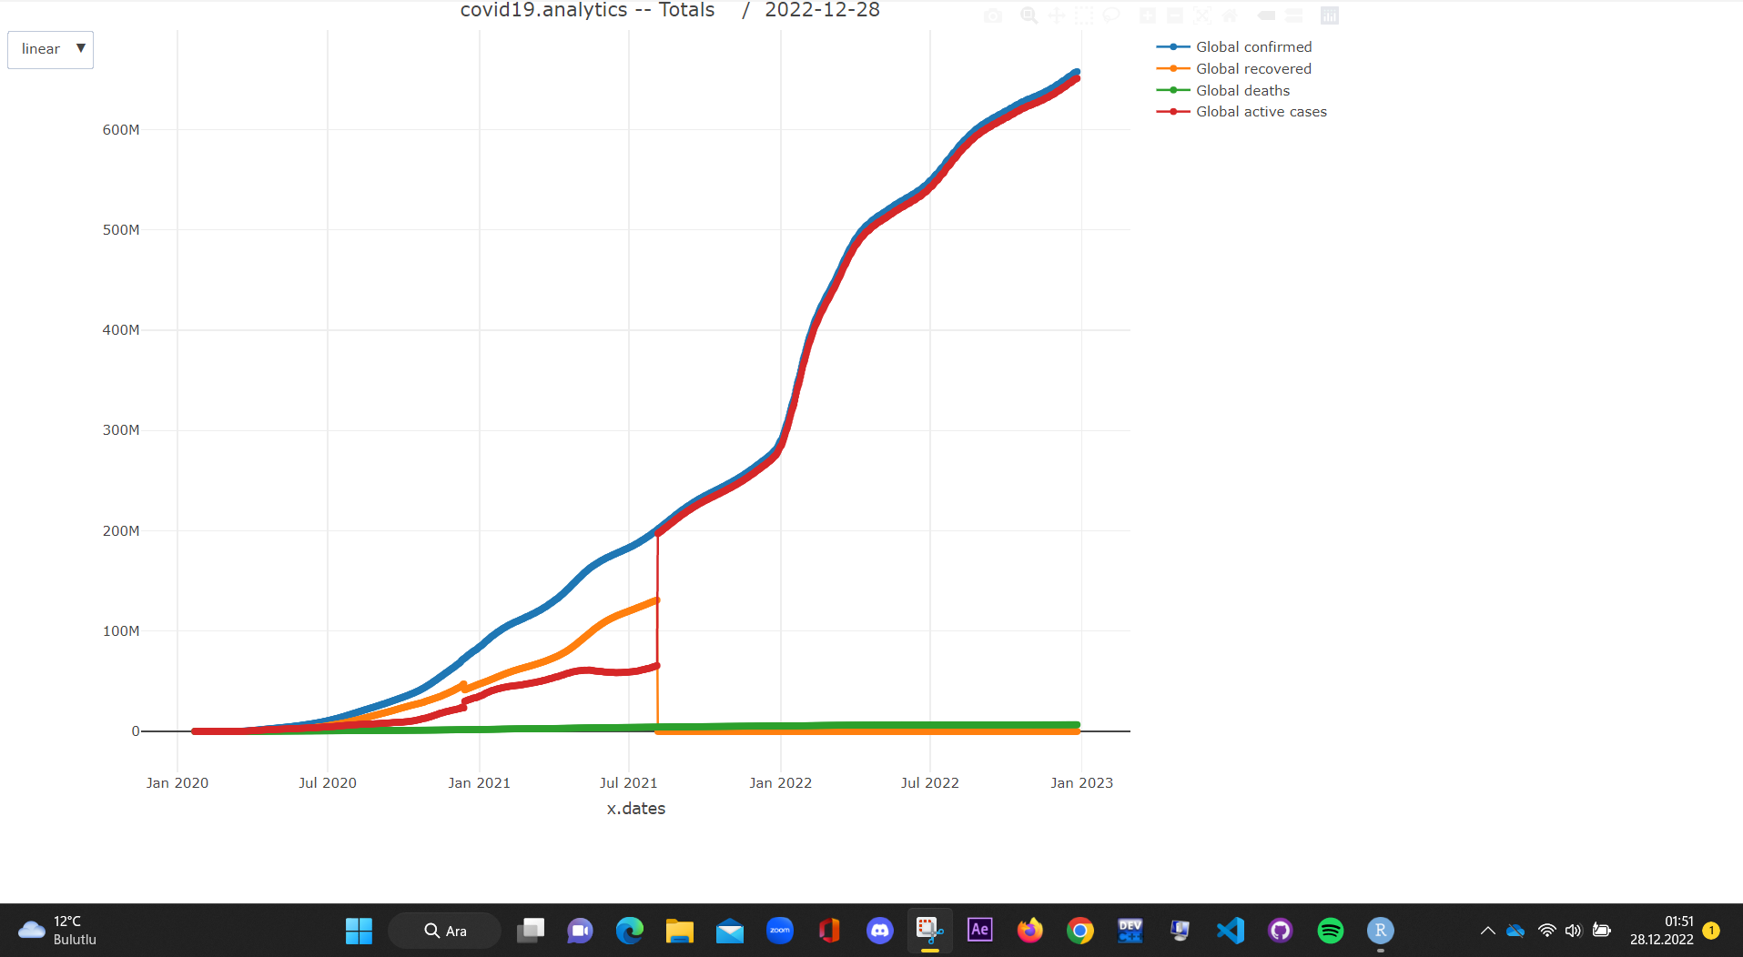

Slide 9
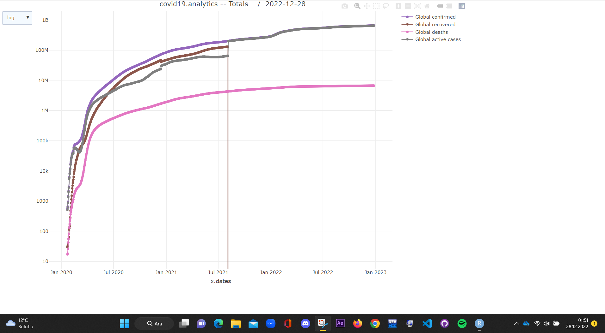

Slide 10
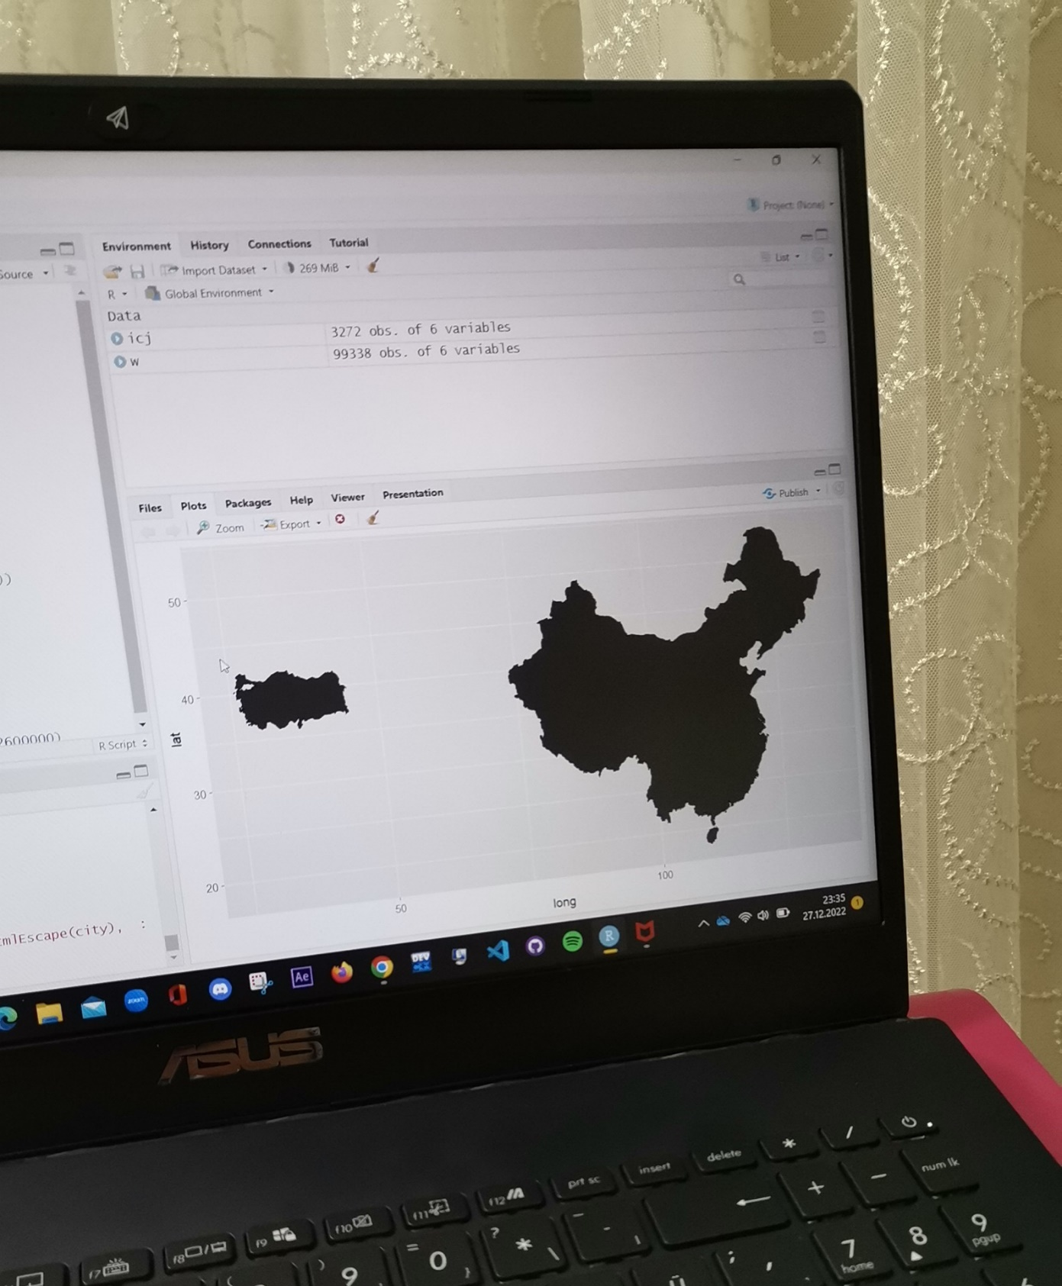
my first way of thinking

Slide 11
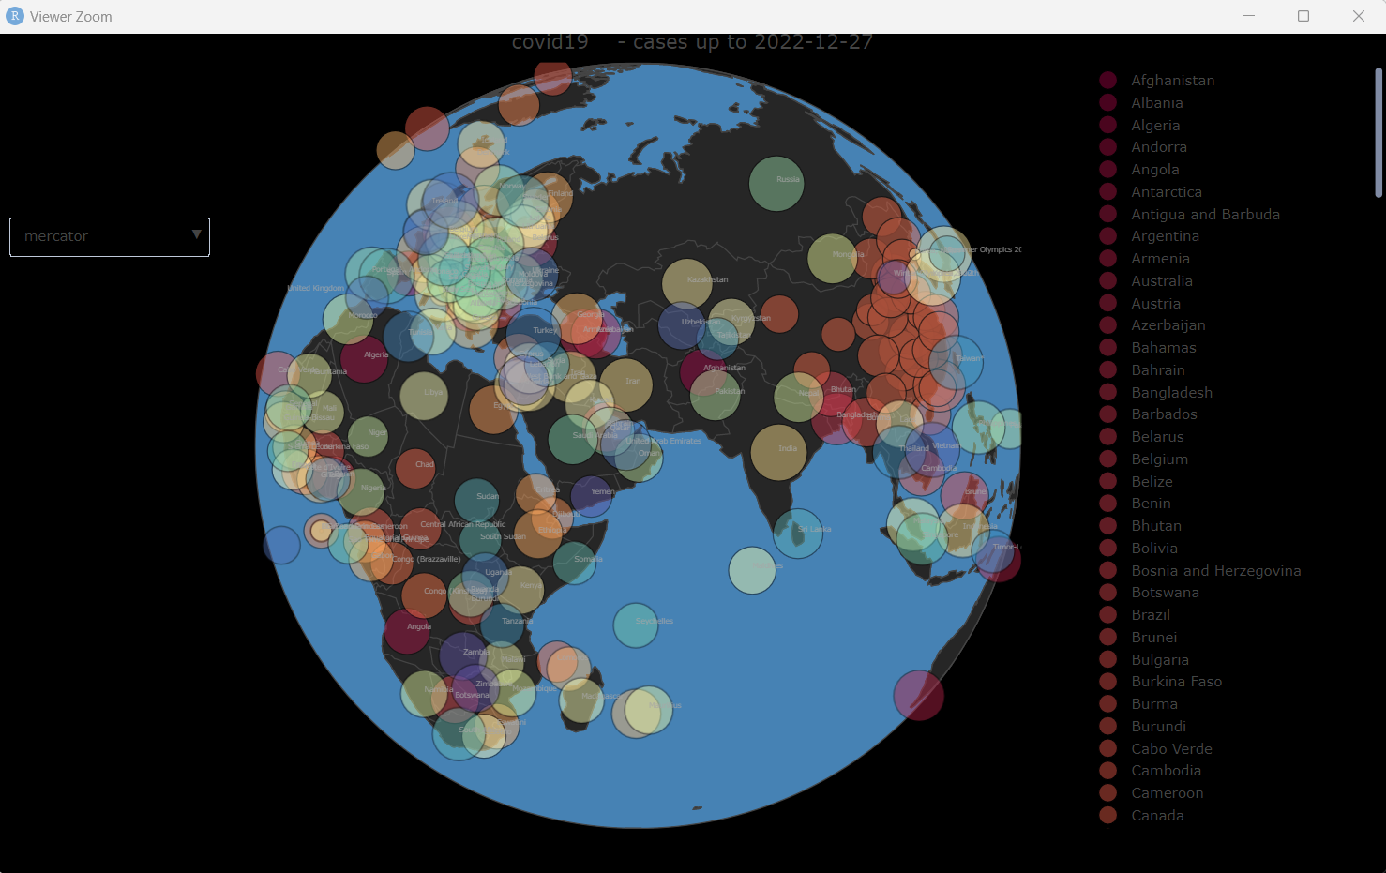
World map covid app

Slide 12
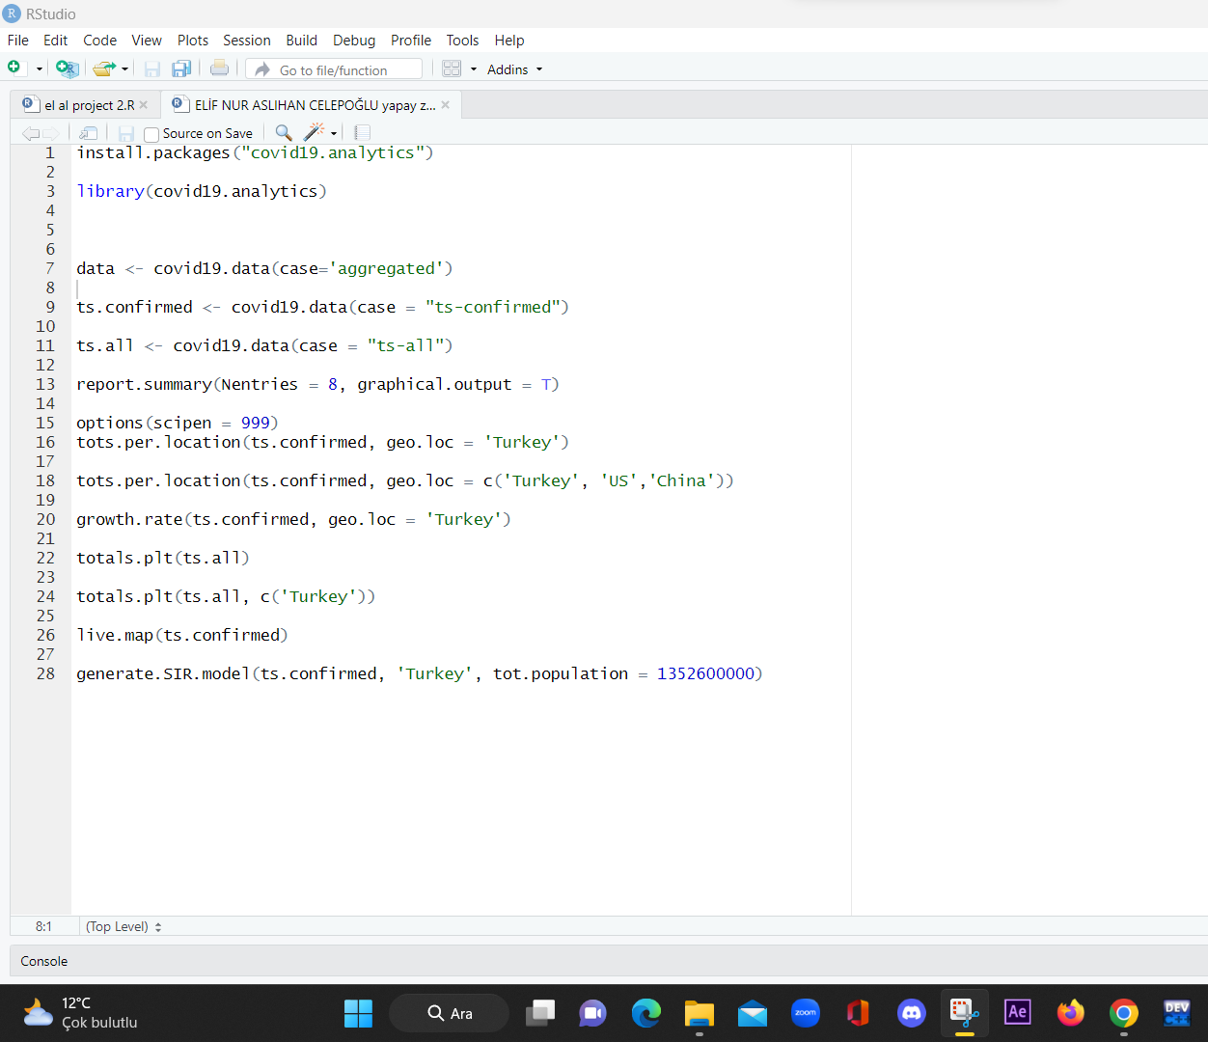
Code

Slide 13
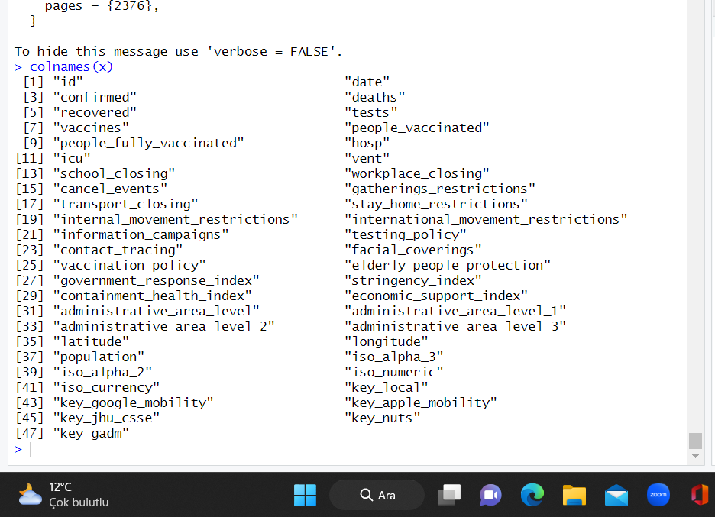
coronavirus
(14016 rows ,47 cloumn)

Slide 14
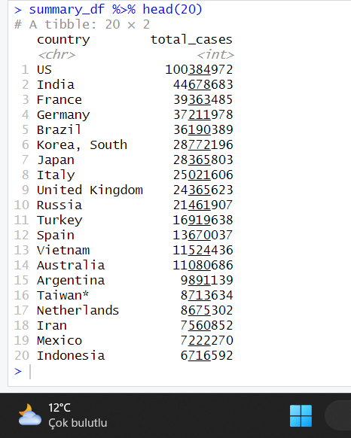
Total cases

Slide 15
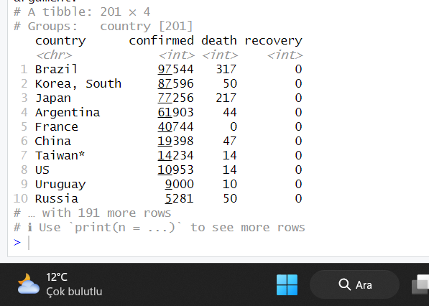

Slide 16
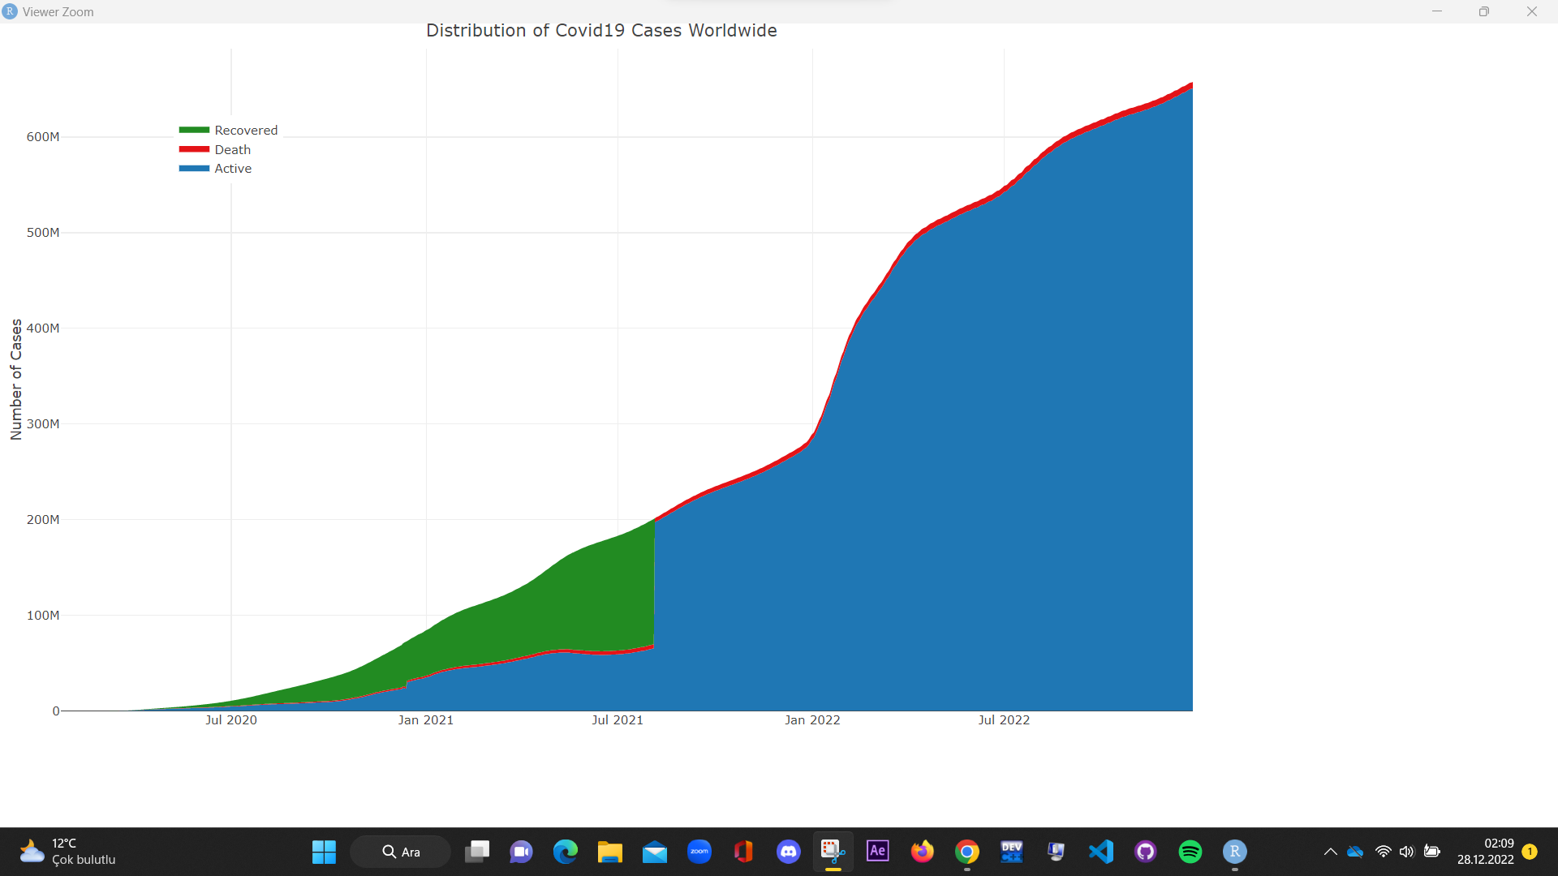

Slide 17
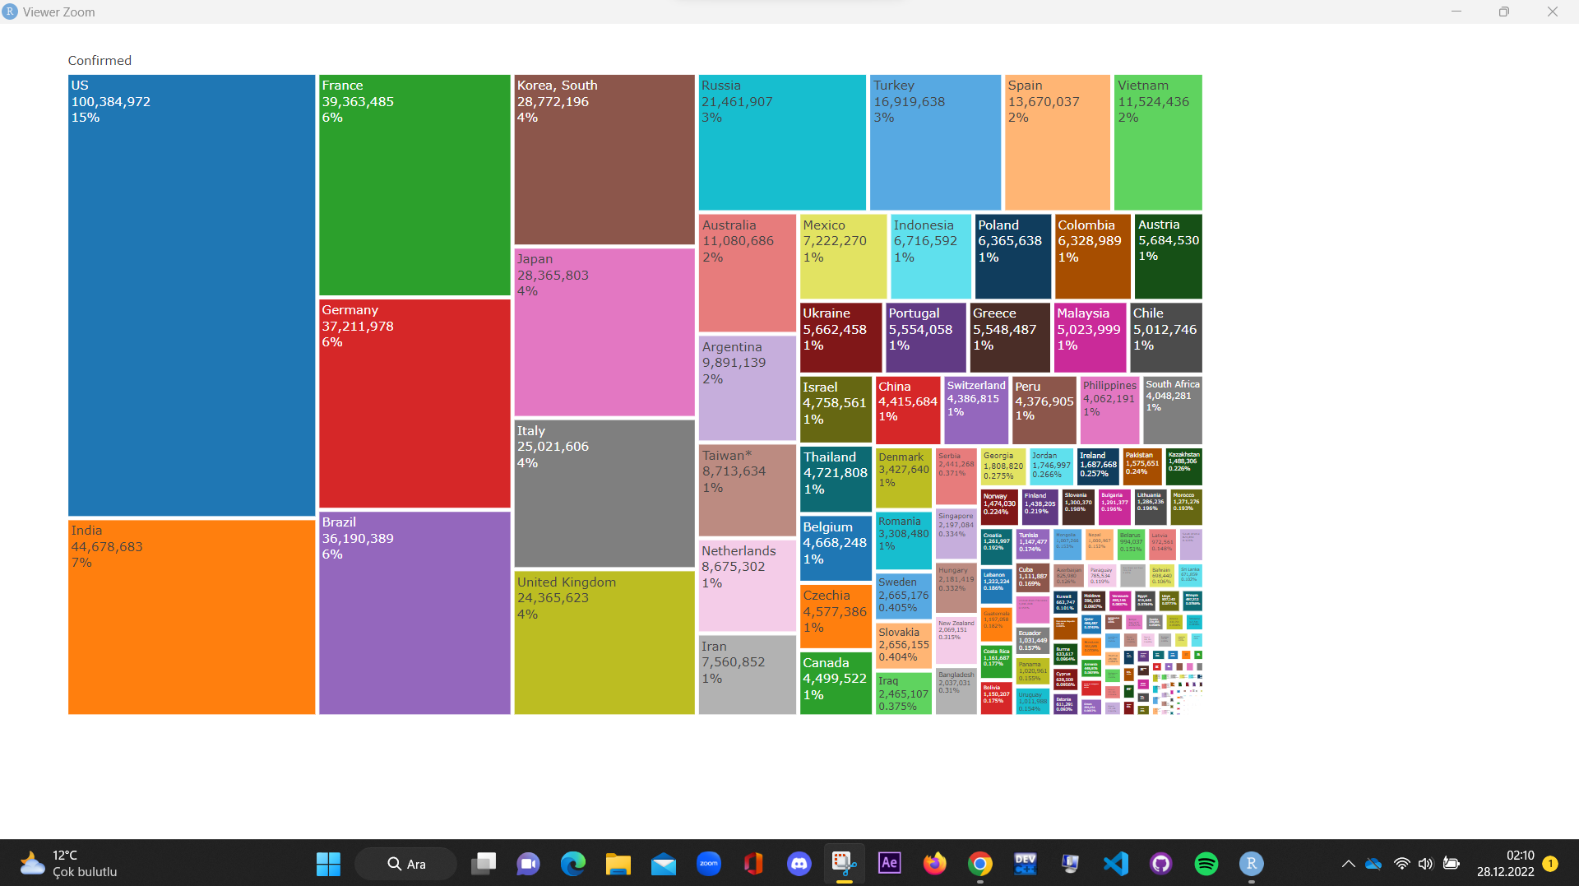

Slide 18
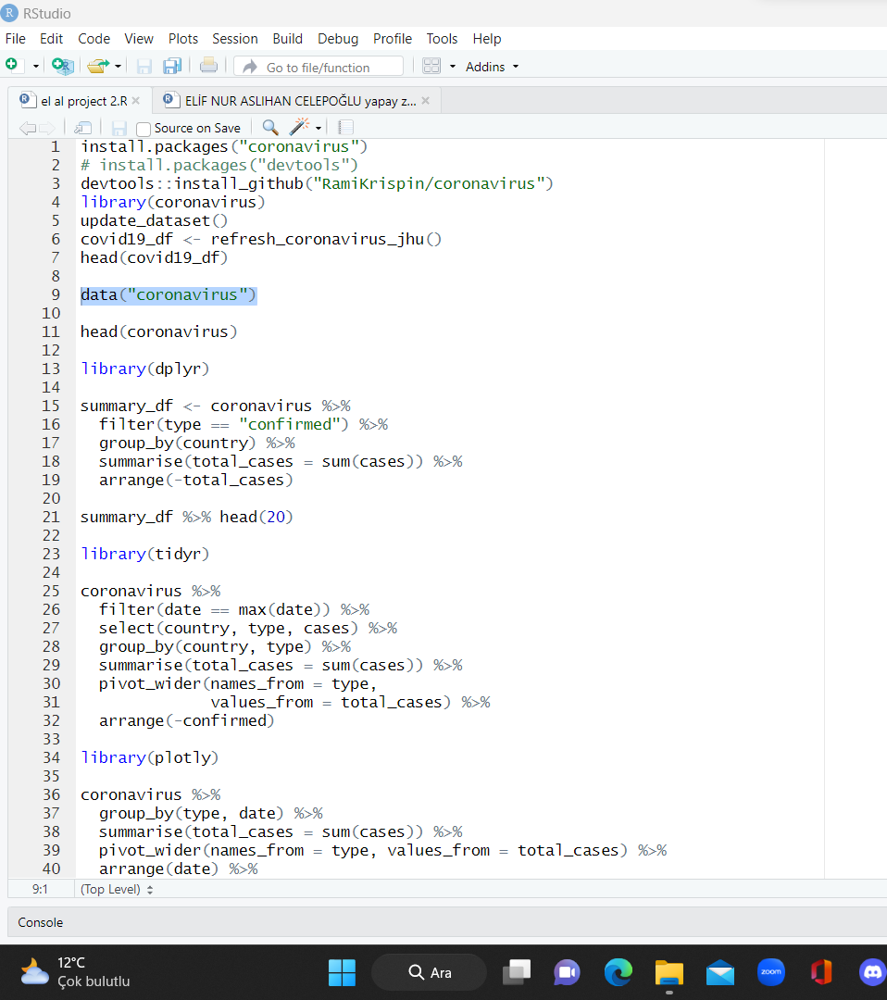
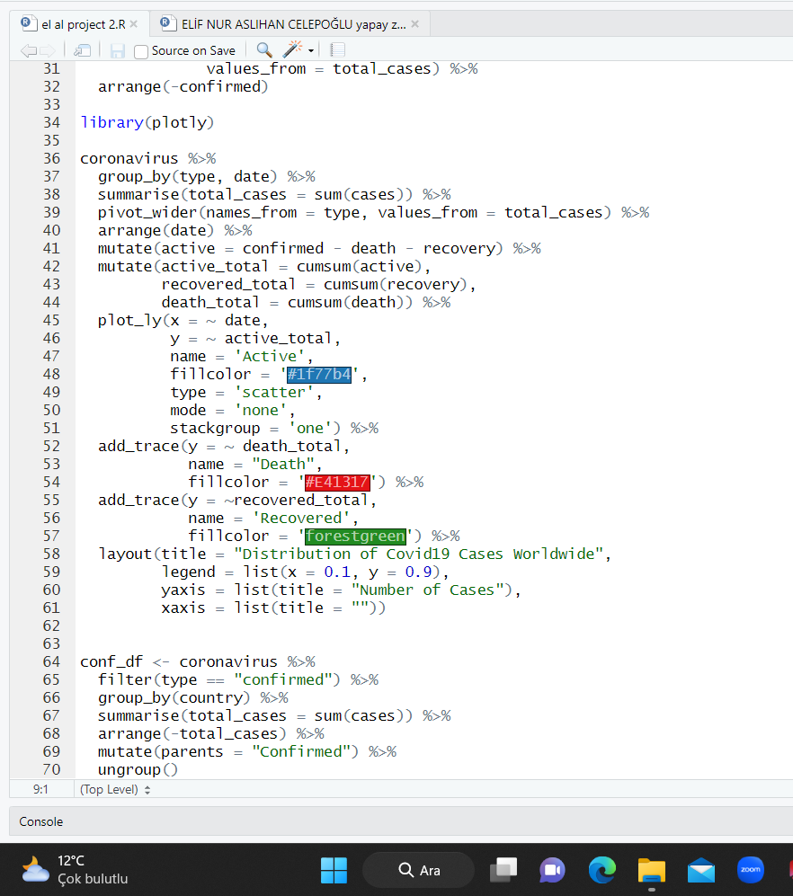
Code

Slide 19
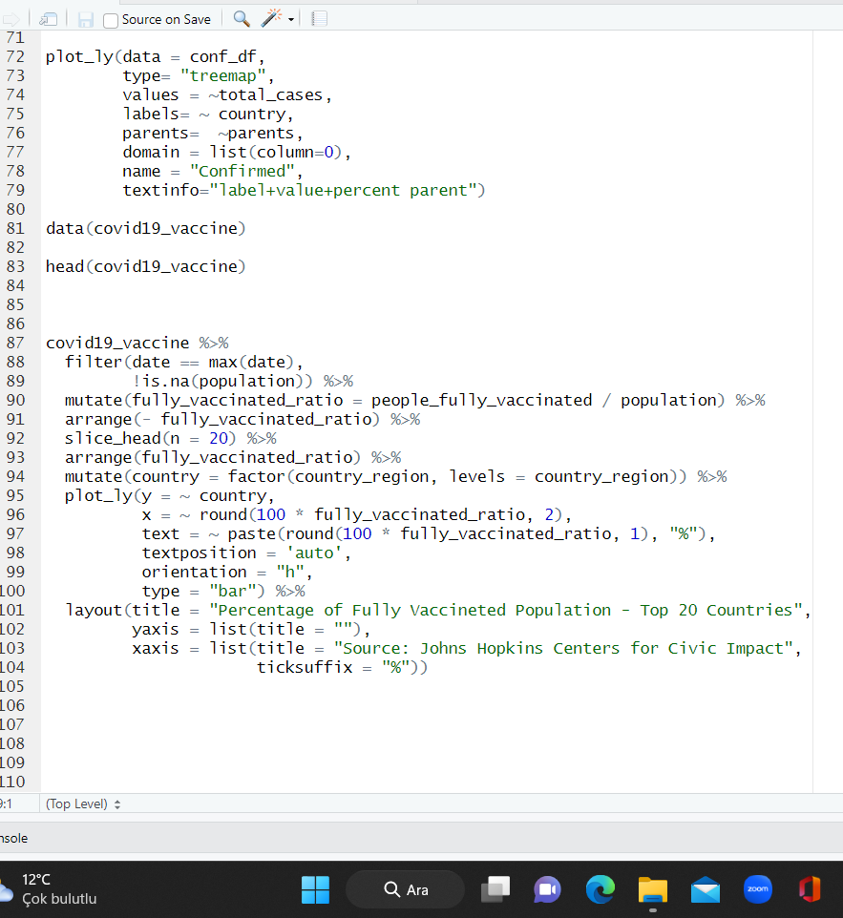

Slide 20
SOURCE
coronavirus- Johns Hopkins University Center for Systems Science and Engineering (JHU CCSE) Coronavirus website
<https://systems.jhu.edu/research/public-health/ncov/>.

